Slide 1
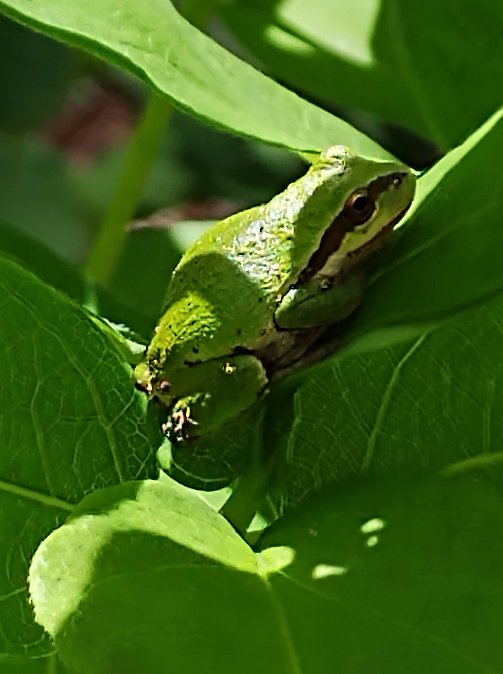
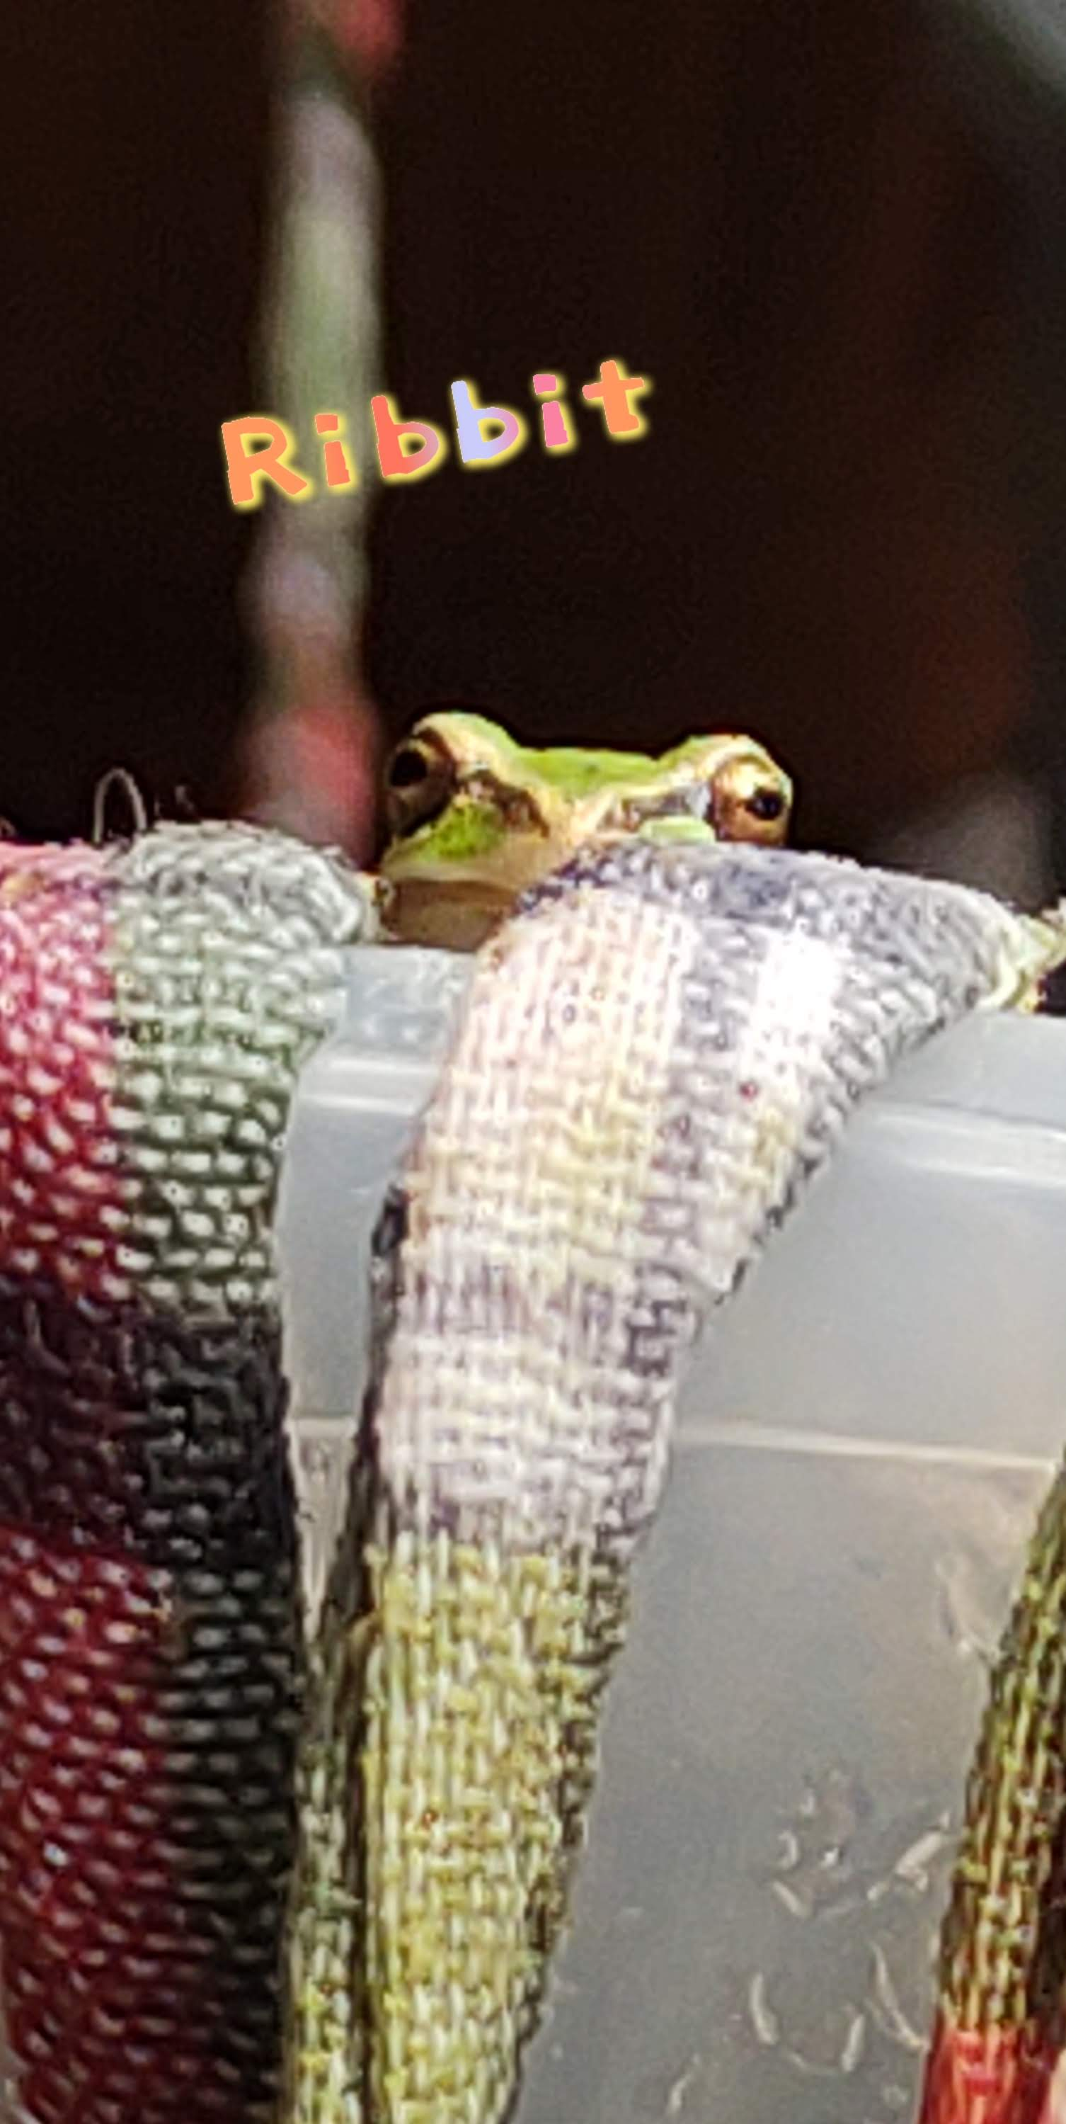
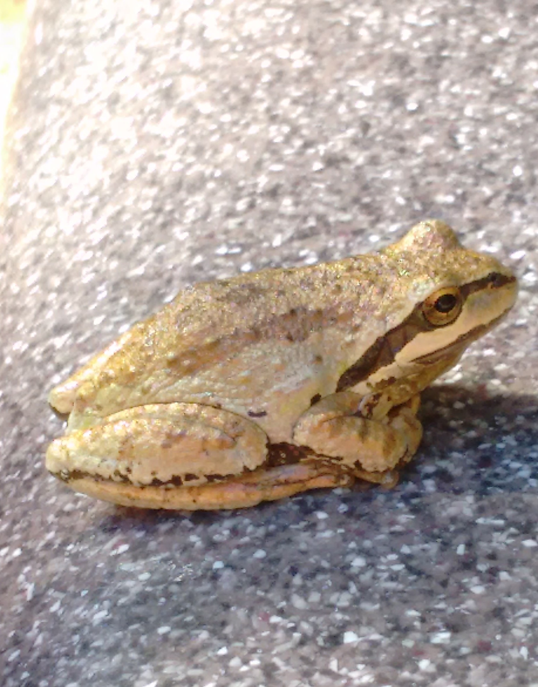
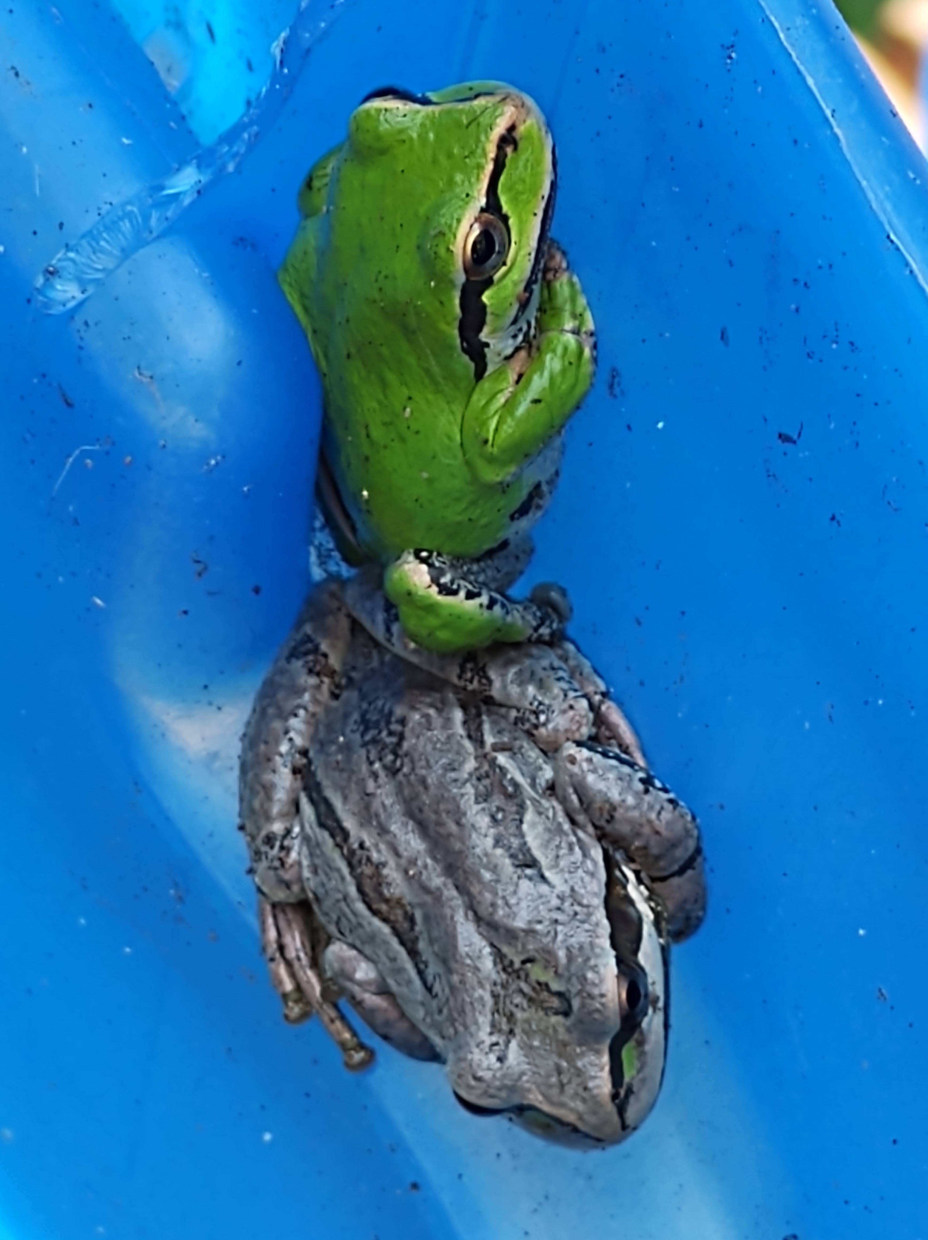
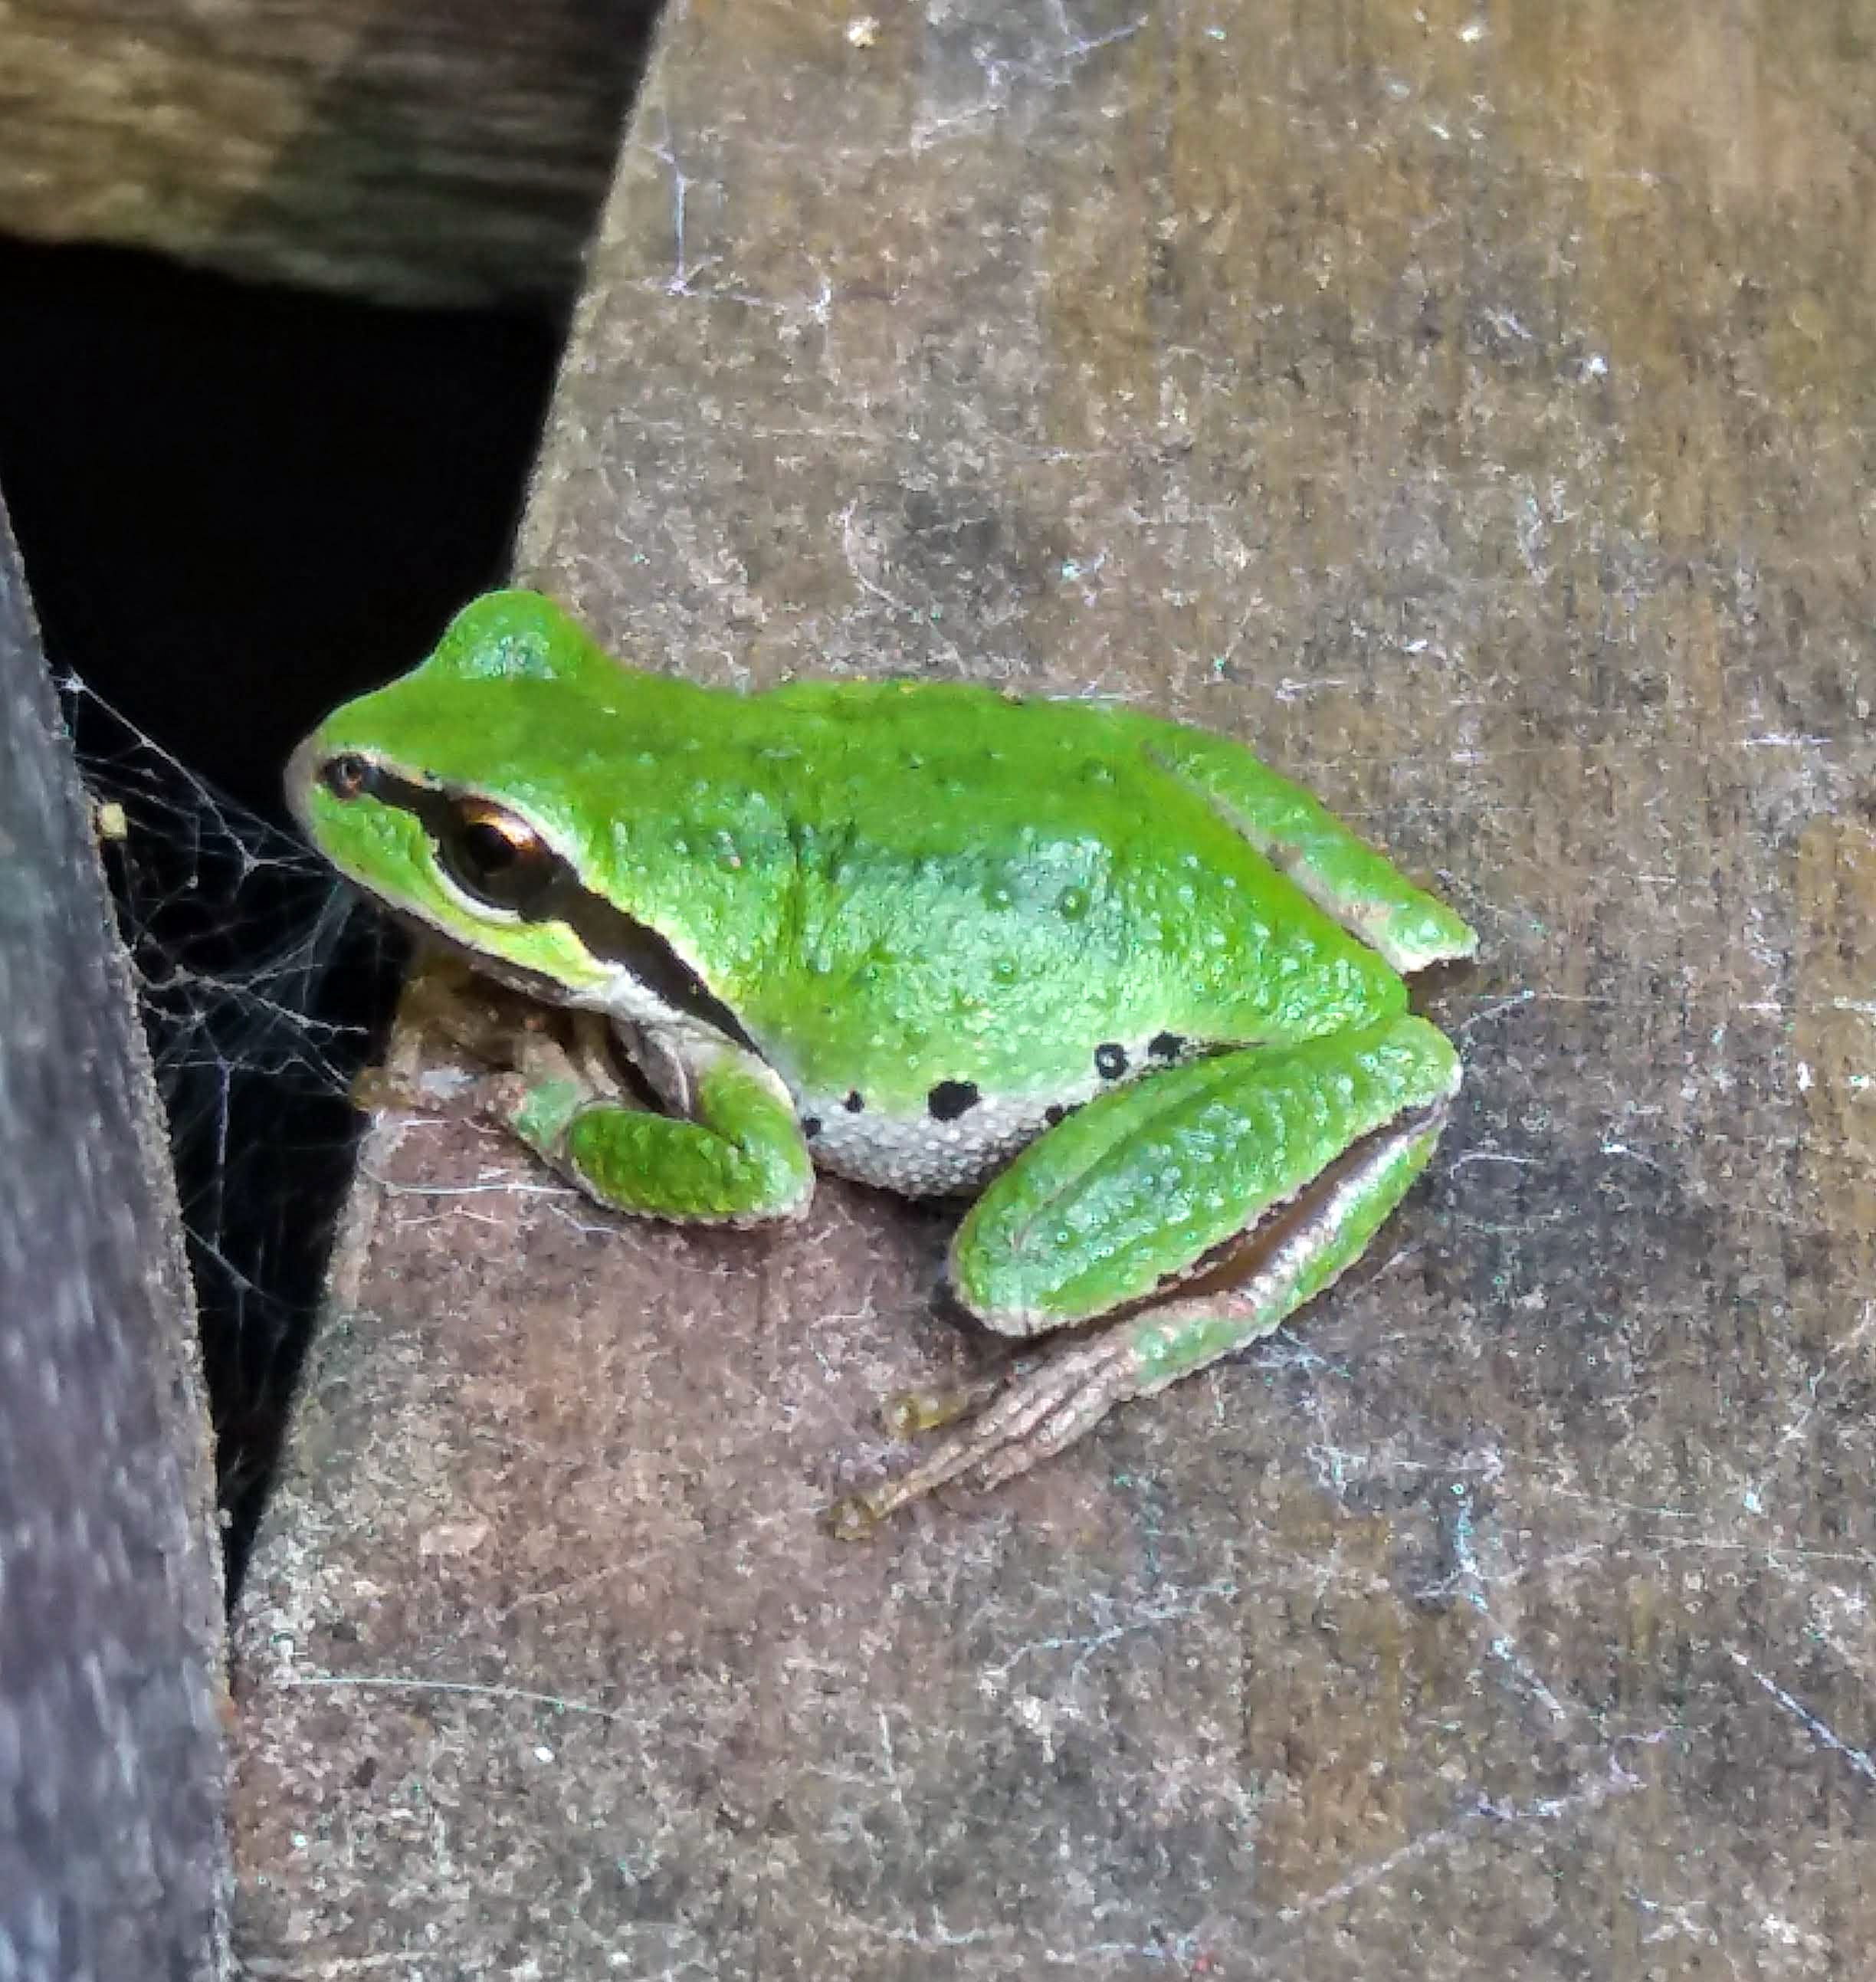
There are two species of frogs on Galiano.
The Northern Pacific tree frog (Pseudacris regilla), which are often bright green, but also come in grey, tan, and brown. They can change colour during the season to better match their environment. The colour change is triggered in response to brightness.

Slide 2
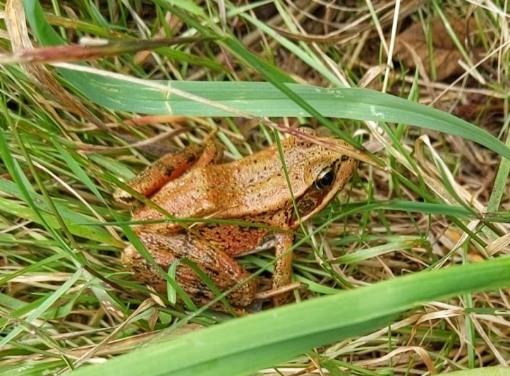
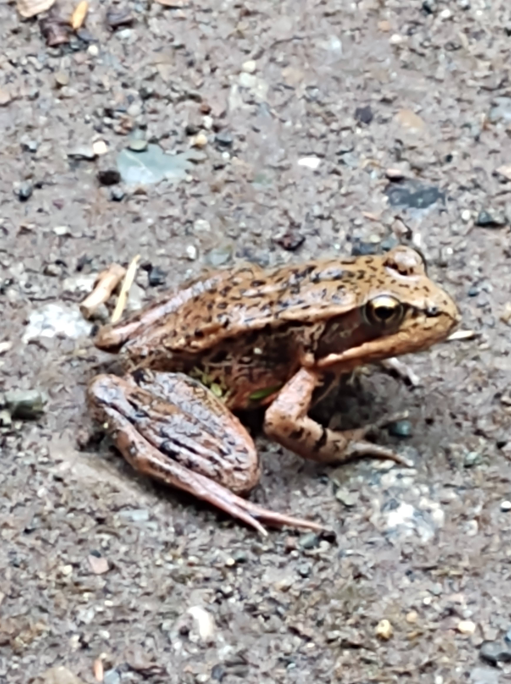
The Northern Red-legged Frog (Rana aurora). Like the tree frog, their colour can also be very variable depending on age, time of year, and location. These frogs are much shyer than tree frogs, and are a threatened species on the Provincial Blue-list

Slide 3

Green tree frogs are also known as the Pacific chorus frog. If you have ever been to Galiano in the spring or early summer, you will likely know why!! Tree frogs are mainly nocturnal. During the day, we often find tree frogs resting up in and around the plant pots on the deck.
Our infra red time lapse camera caught this one hopping around in the middle of the night
Tree frog chorus

